Slide 1




NEXT GEN EMPLOYABILITY PROGRAM
Creating a future-ready workforce
Team Members
College Name
Student Name :Mohamed Fathima ihsaana A H
Student ID : 960221104075
ARUNACHALA COLLEGE OF ENGINEERING FOR WOMEN

Slide 2

CAPSTONE PROJECT SHOWCASE
Project Title
Car Rentals Application with Django Framework
Abstract | Problem Statement | Project Overview | Proposed Solution | Technology Used | Modelling & Results | Conclusion

Slide 3
Abstract
Car rental management system is a project which aims in developing a computerized system to maintain all the daily work of Car Rental .This project has many features which are generally Not available at regular car rental stores , like facility of customer login and a facility of admin login .It also has a facility of admin login through which the admin can monitor the whole system .It also has facility of an online notice board where Admin can put up information about the cars available in the exhibition and their prices and updating all data that go through the rental process. It has also a facility where user after logging in their accounts can see list of cars and its price and Availability of the car and also the customer can request the admin to add new type of cars by filling the cars request form. The admin after logging into his account is admin account can generate various reports such as cars report, users/ customer report. Overall, this project of ours is designed to help anyone make it easier during the process of buying or renting a car in the best possible way, as well as reducing human efforts and obtaining the best offers
Source :

Slide 4
Problem statement The Manual car rental system provides services only during office hours. So customers have limited time to make any transactions or reservations of the cars. The existence of the online car rental systems nowadays has overcome the limitation of the business operation hour. Most of the systems offered reservation service for tourists or travelers. Besides that, there are some customers who faced a problem in choosing car to be rented which suitable with some of the important requirements, 1. To rent a car a prospective renter must first go to the nearest office to register as a client. 2. Cars that provide difficulties to rent out are normally advertised in local or national newspaper.It involves a lot of paperwork and consumes time
Source :

Slide 5
Project Overview This Car Rental System project is designed to aid the car rental company to enable renting of cars through an online system. It helps the users to search for available cars view profile and book the cars for the time period. It has a user-friendly interface which helps the user to check for cars and rent them for the period specified. They could also make payment online. The rental cars shall be categorized into economy, premium etc. Based on the type of car required by the customer, the user shall be able to make bookings. The use of internet technology has made it easy for the customers to rent a car any time. This Car Rental System makes the bookings easy. It saves time and labor. The tool shall ask the user for information such as the date and time of journey, type of car etc. Also, it will need an identification number. Using these details, the tool shall help the customer to book a car for the journey.
Source :

Slide 6
ProposedSolution This Car Rental System project will enable the user to rent a vehicle. The user shall login to the system and check for availability of cars. The user specifies a type of car and the journey date and time. The Car Rental System shall check for the availability of the car and rent the car to the customer. The user can make payment online. The tool is designed using visual studio,html and python. All the data regarding the rental cars are stored in github link. The user has to enter his name, address, phone details and check for the cars available for rent. The UI is very simple and the connectivity to back end is robust. The main advantage is that the user shall be able to choose a car depending on his budget.
.
Source :

Slide 7
Source :

Slide 8
Source :

Slide 9


Technology Used
Front-end
Back-end
Source :

Slide 10
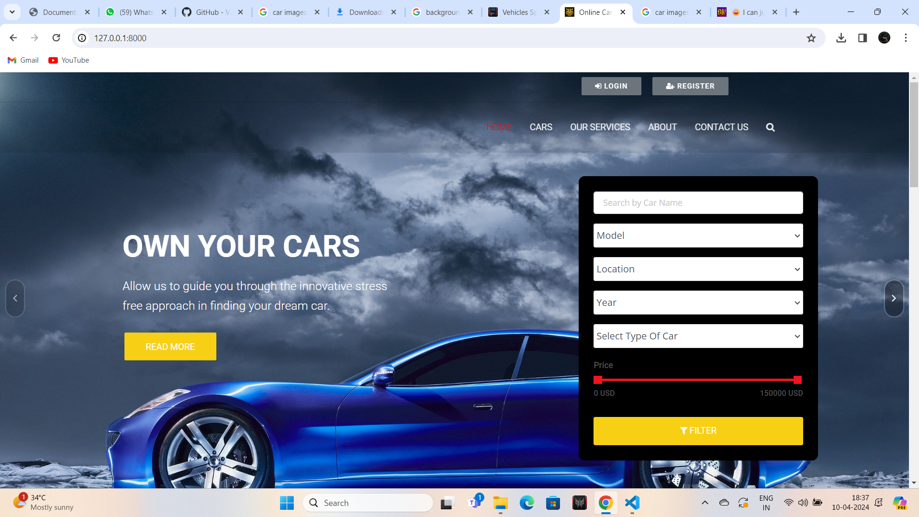
Modelling & Results
Source :

Slide 11
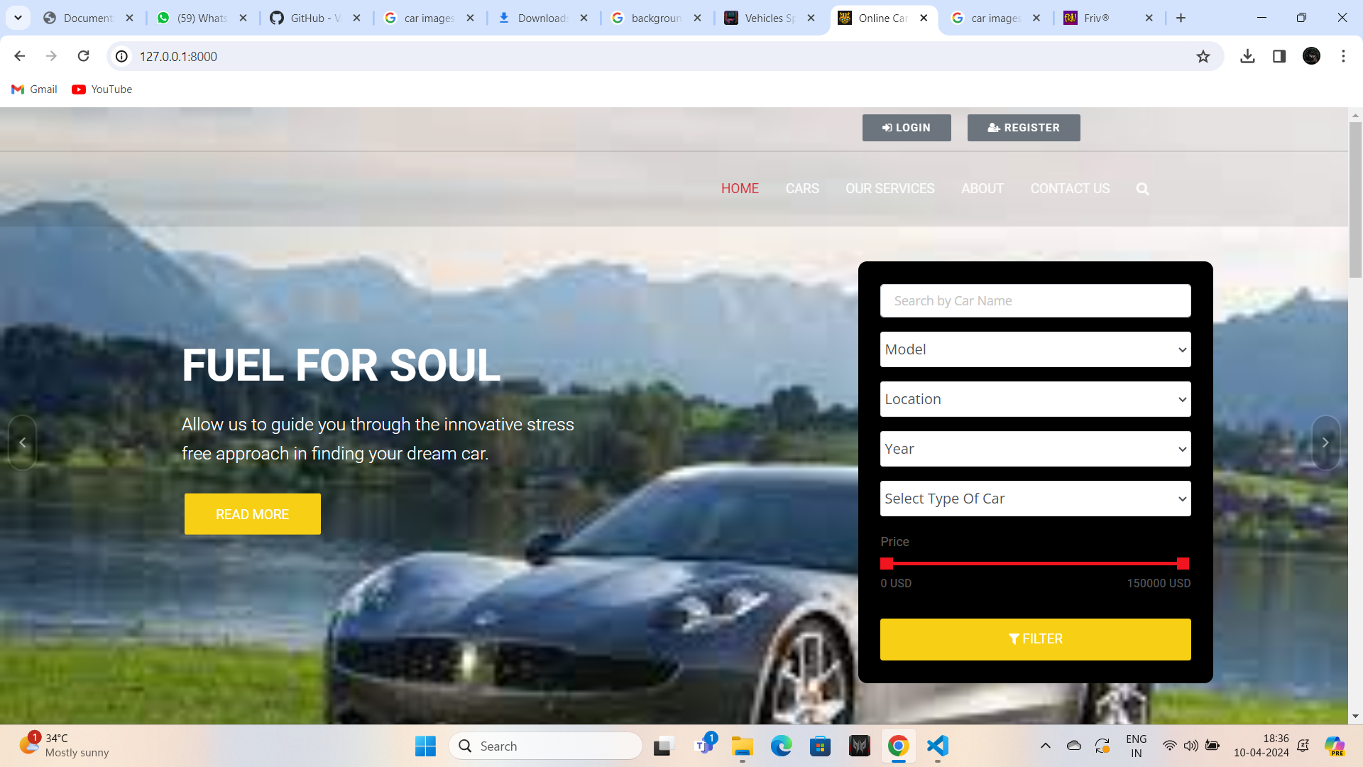
Homepage

Slide 12
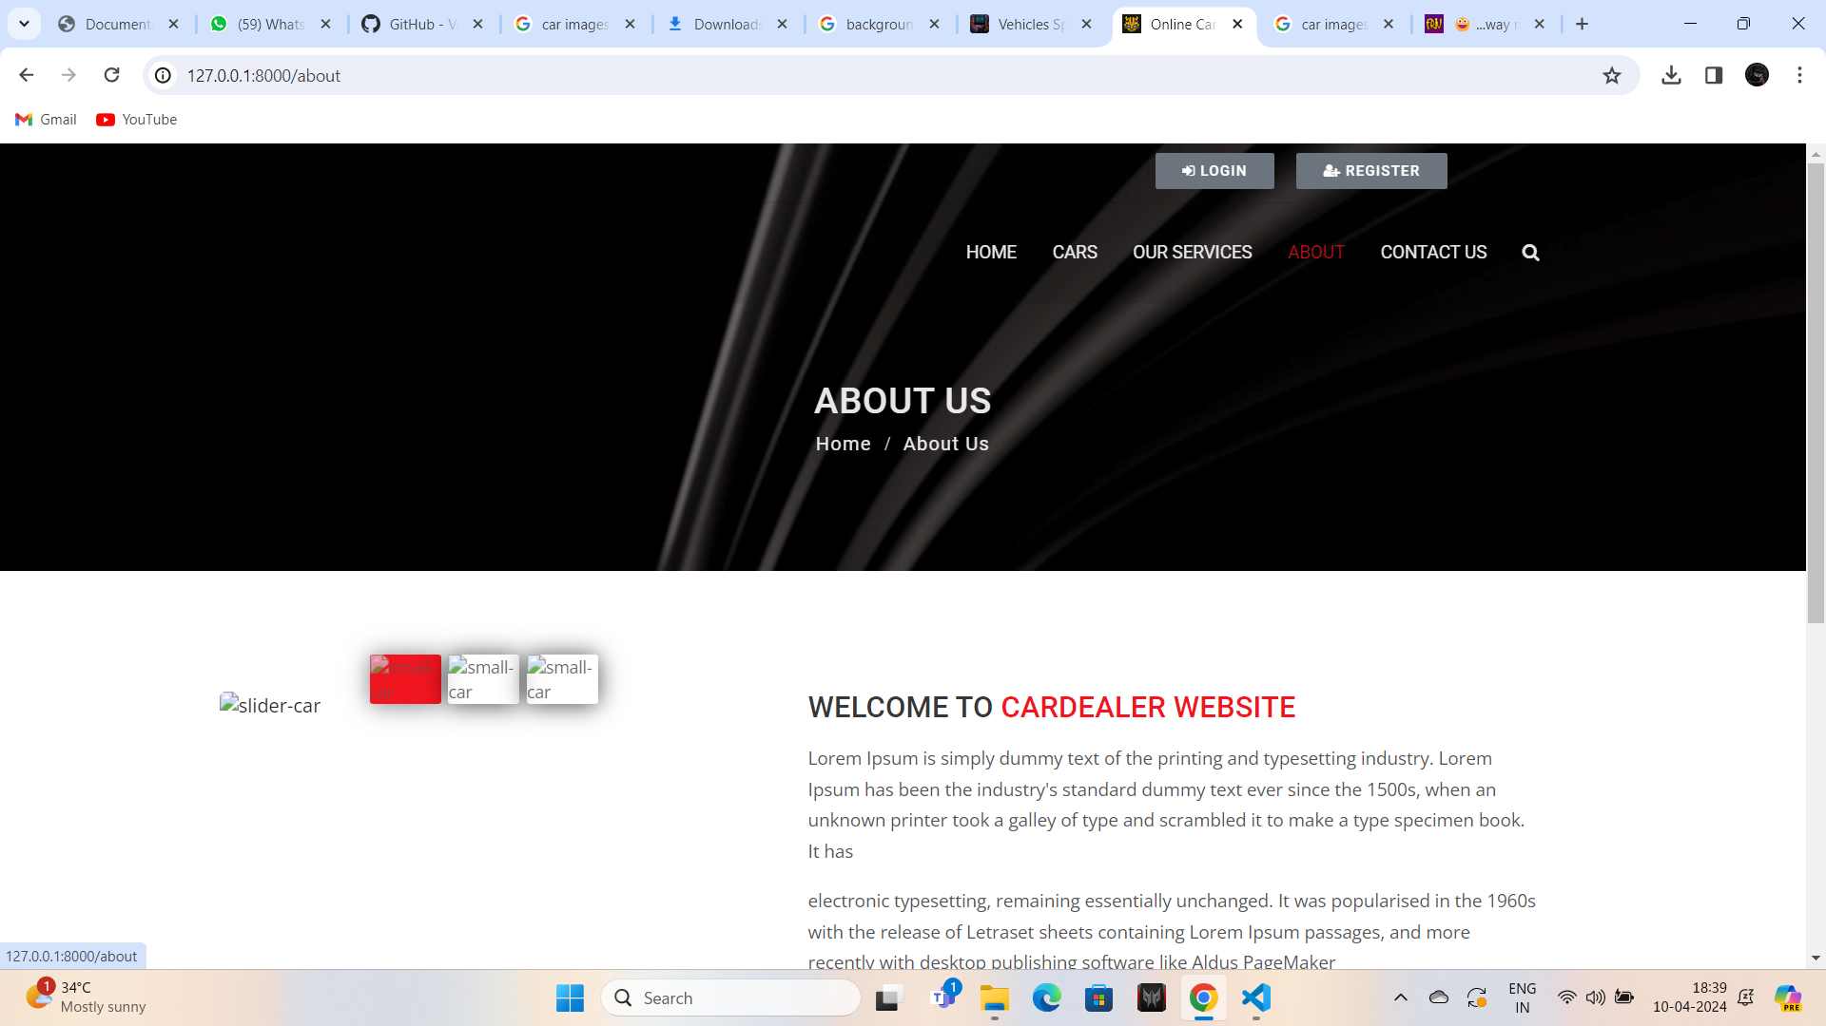
About-Us-Page

Slide 13
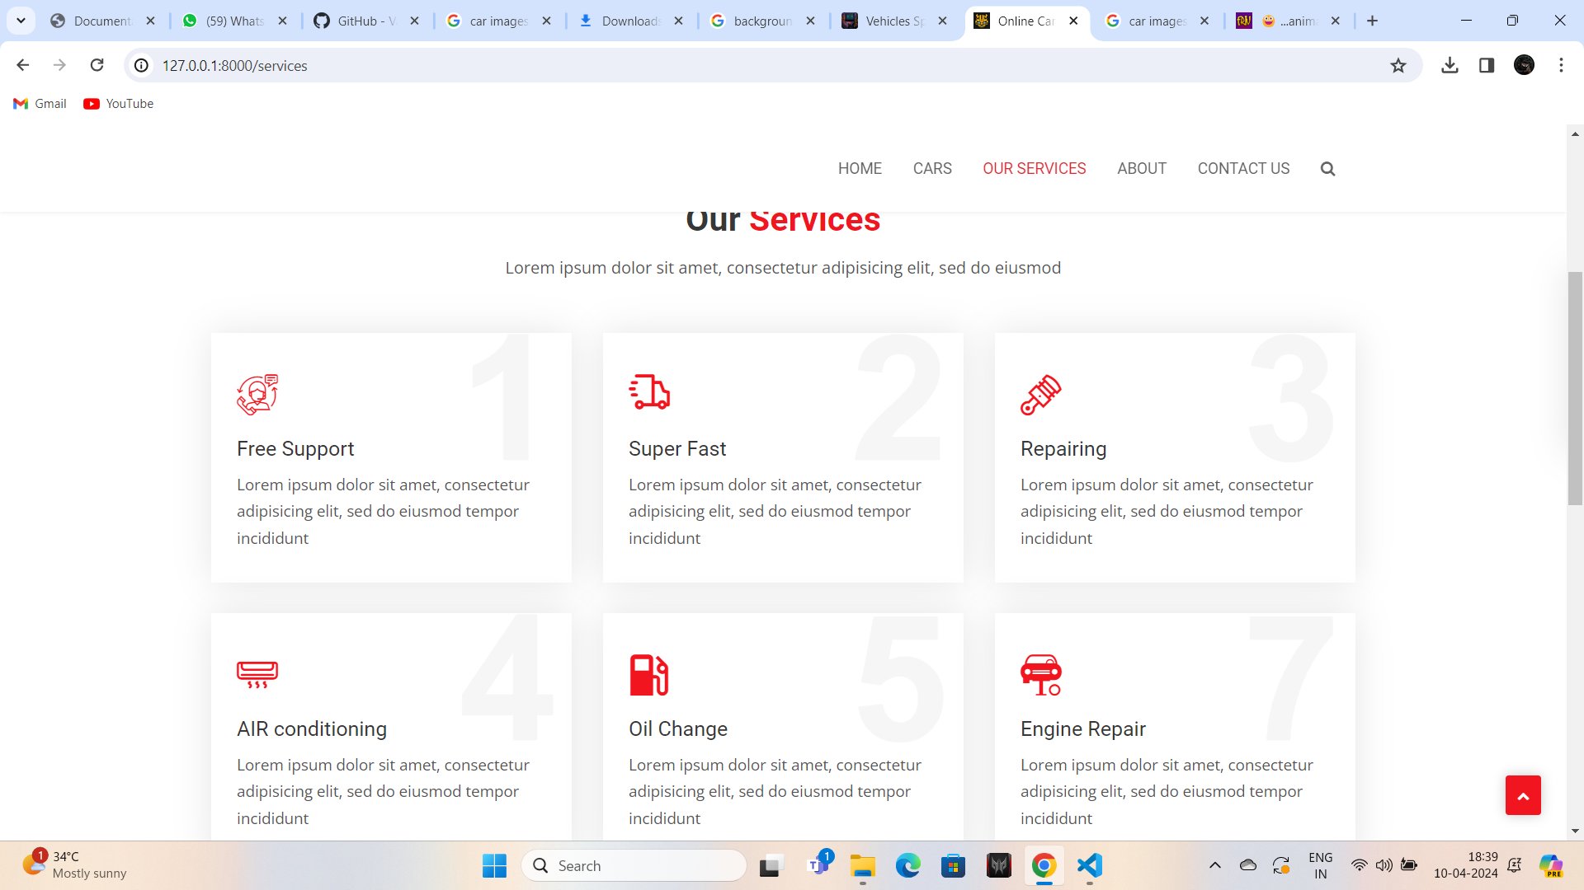
Service-Page

Slide 14
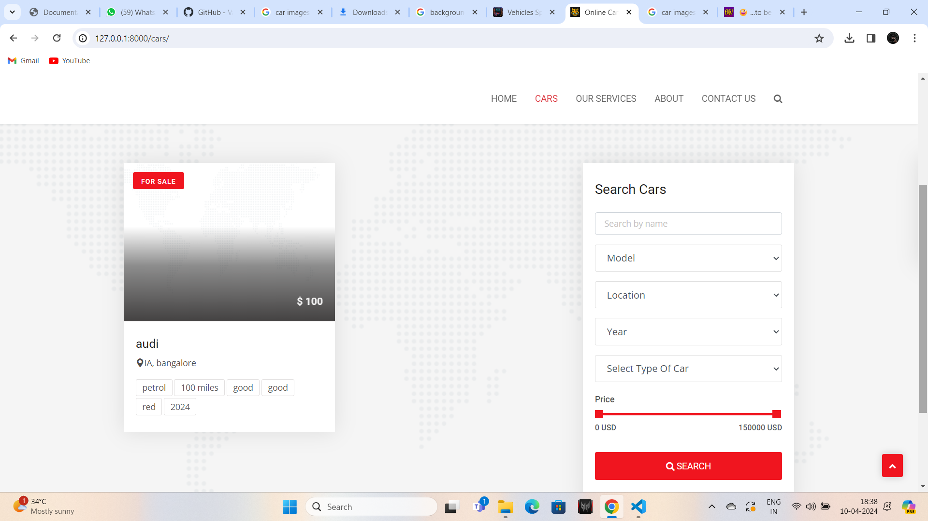
Departments-Page

Slide 15
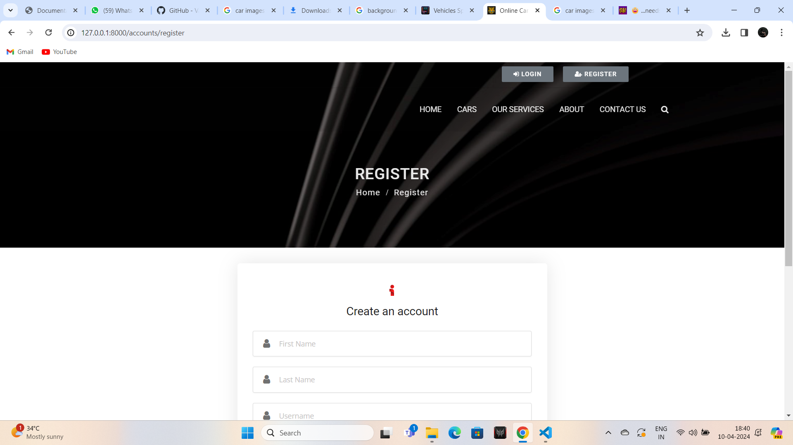
Blog-Page

Slide 16
Future Enhancements:
Car rentals certainly have a big future, mainly due to fuel hikes and increasing price rises of cars.
Cab services and car rentals are growing in popularity and are easy on the pocket.
Some people, living in busy cities, prefer rentals because of lack of sufficient parking spaces and rushing through their day with
very little time on their hands.The growth of the global car rental market is adequately
measured in the graphic made by Mordor Intelligence. Almost 80% of countries worldwide are of the
view that car rentals are convenient and pocket-friendly. The main exception is Africa, but a case could be
made because of their underdeveloped economy.

Slide 17
Conclusion In comparison to previous experiences, when every activity related to the vehicle rental business was restricted to a physical place alone, the car rental industry has emerged with new delicacies. Even if the physical location has not been completely eliminated, the internet's power has altered the nature of functions and how these tasks are accomplished. Customers may now book vehicles online, rent automobiles online, and have the car delivered to their home if they are a registered member, or they can travel to the office to pick up the car.
Source :

Slide 18
Thank You!
Notes:
Thank You !!

